Slide 1
Optimizing SQL/PGQ
Mar, 2024

Slide 2
Contents
SQL/PGQ
Optimizer for SQL/PGQ
Overview
Experimental Results

Slide 3
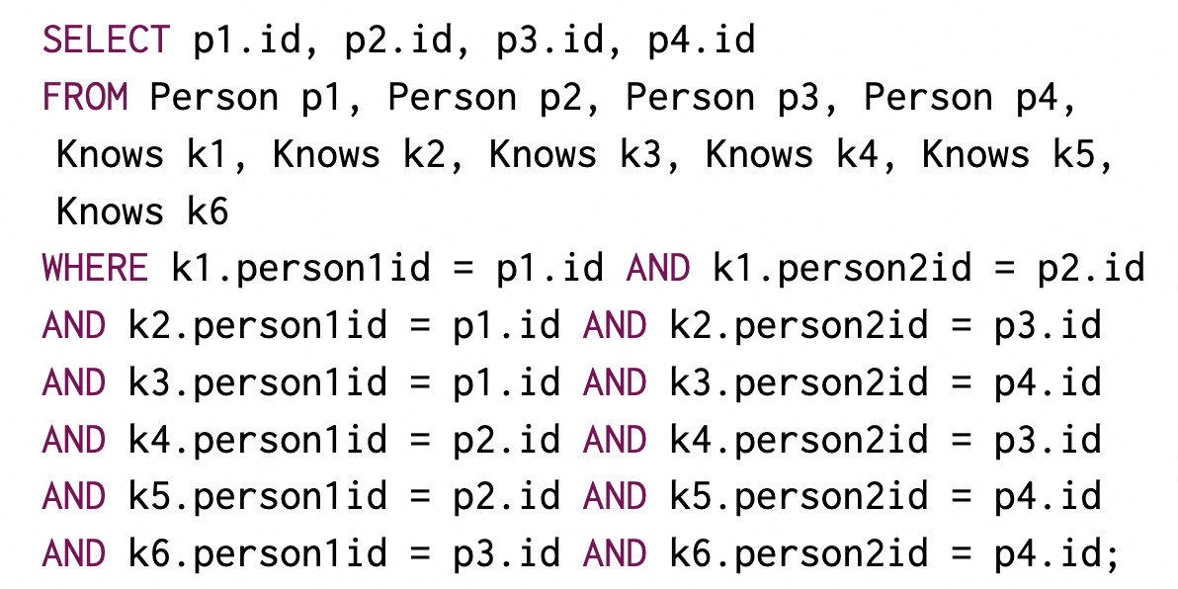
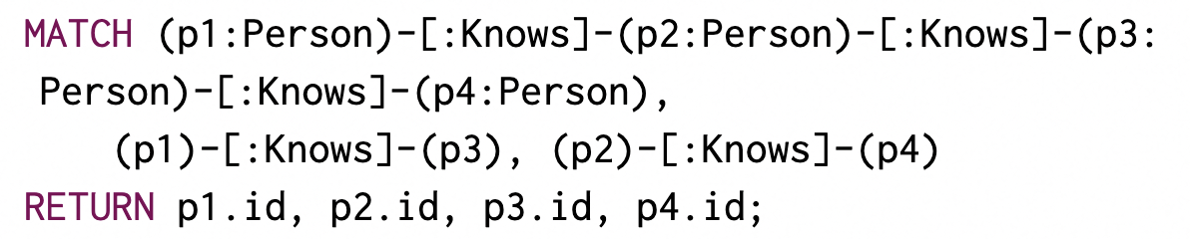
SQL/PGQ
find four persons know each other with SQL
with GQL (e.g., Cypher)
More concise
Necessary to add GQL queries to SQL (SQL/PGQ)

Slide 4
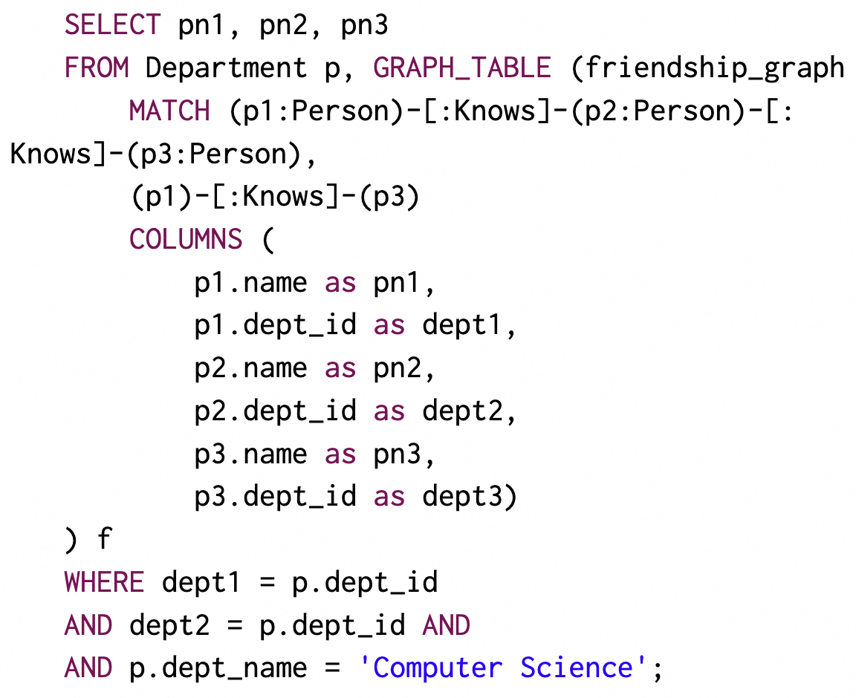
SQL/PGQ
find three persons knowing each other, and two of them are from the department of ‘Computer Science’

Slide 5
SQL/PGQ
find three persons knowing each other, and two of them are from the department of ‘Computer Science’
Relational Query
Graph Indices are built
Adj(e)
- get adjacent vertices
Adj(v)
- get adjacent edges
Neighbor(v)
- get neighborhoods
Optimizer for SQL/PGQ
Graph Query
Relational Query

Slide 6
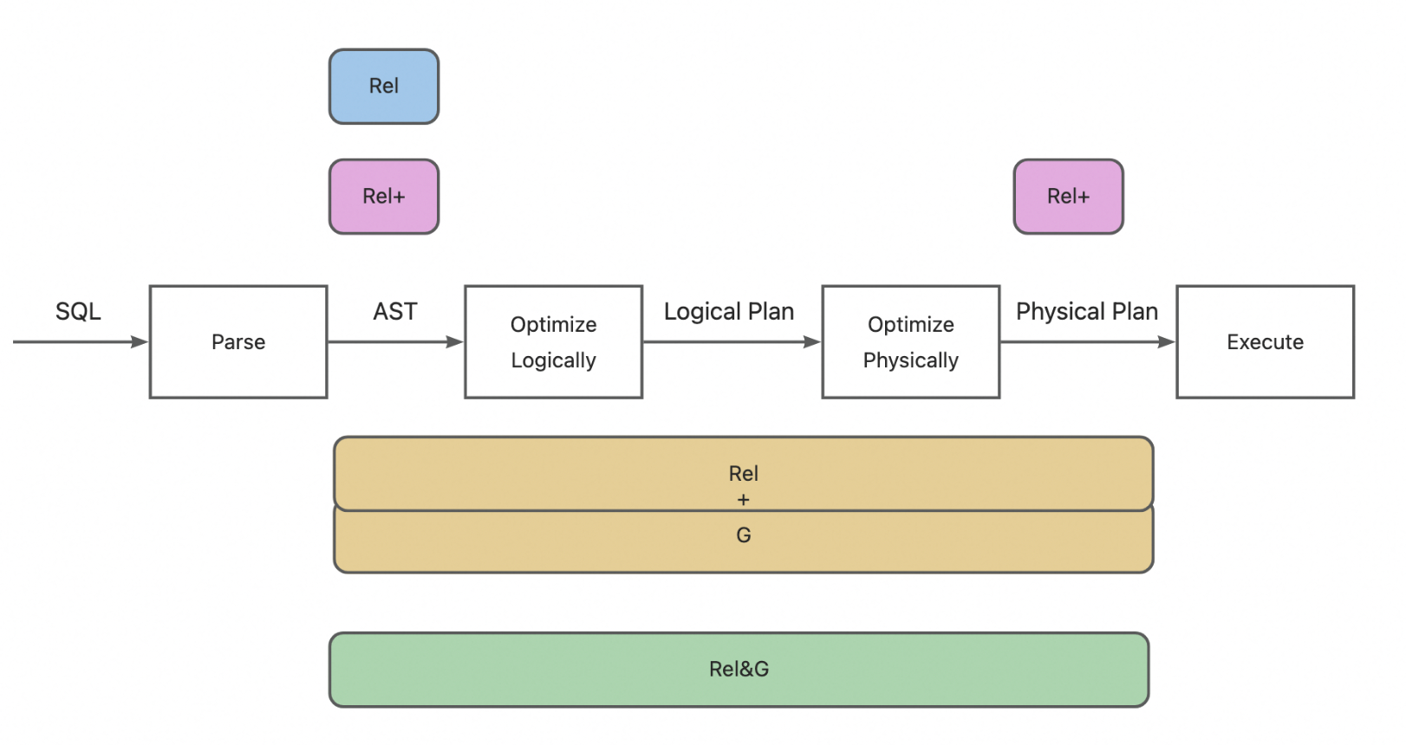
Optimizer for SQL/PGQ
Four Types of Solutions
Based on the stages that the solutions are involved in:
Rel
Rel+
Rel + G
Rel & G

Slide 7
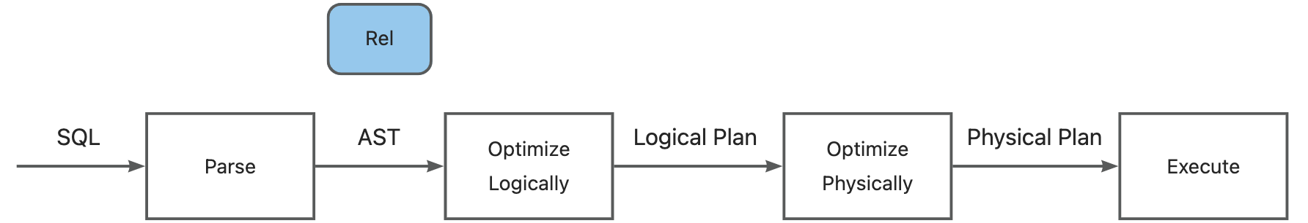
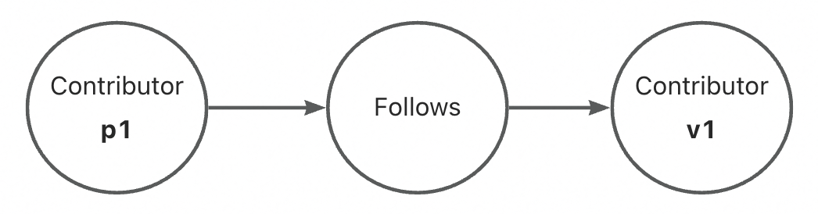
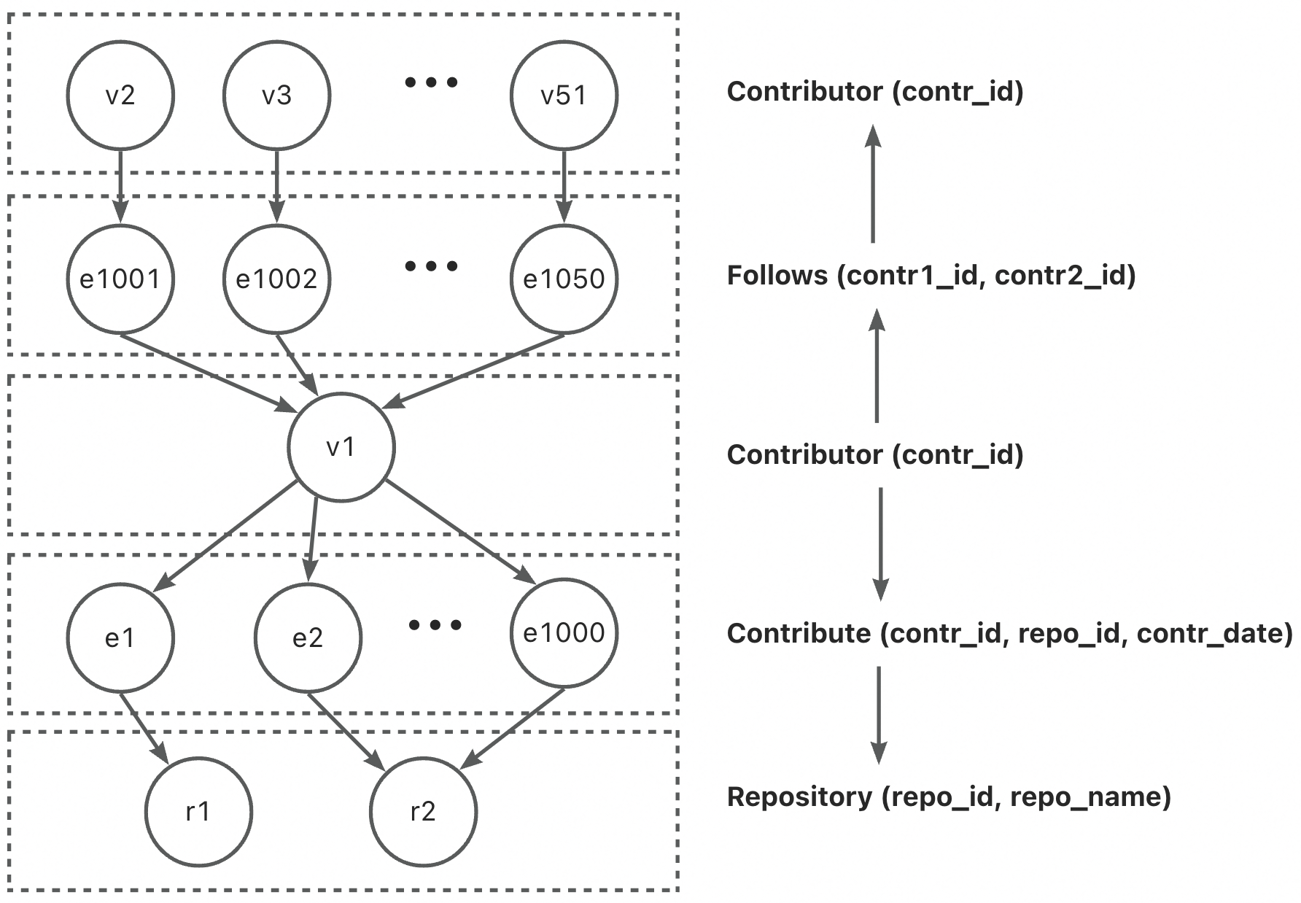
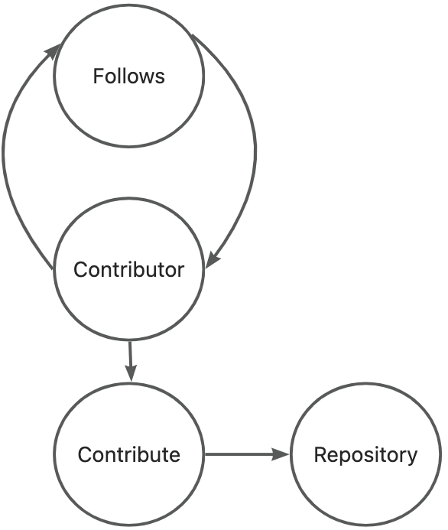
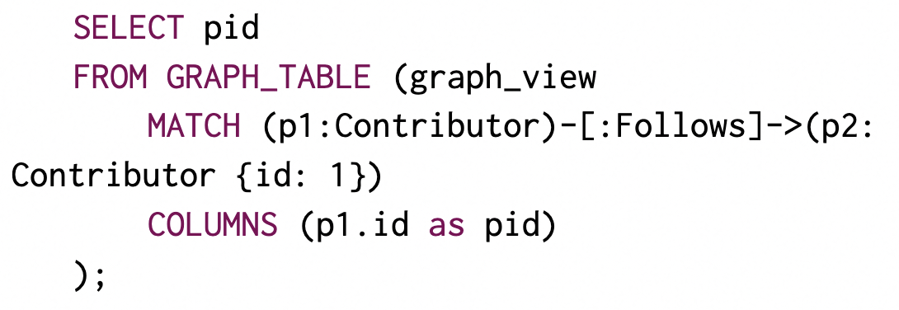
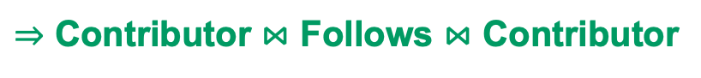
Optimizer for SQL/PGQ
Rel
Translate graph queries to
relational queries
- Apache/Age
find persons that follows person 1
$⇒$ Contributor $⋈$ Follows $⋈$ Contributor
Graph Indices are not used !

Slide 8
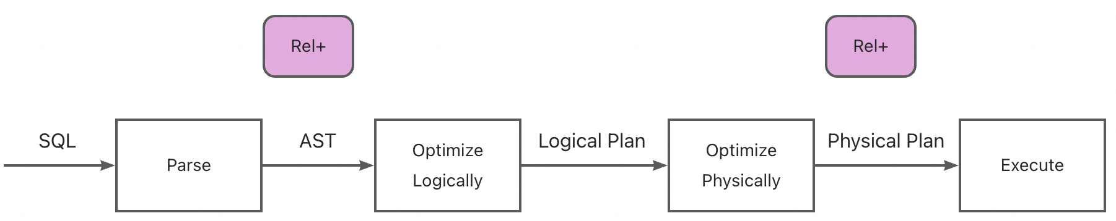
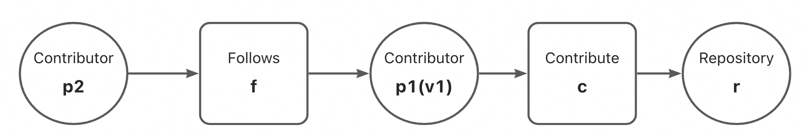
Optimizer for SQL/PGQ
Rel+
Translate graph queries to relational queries, and introduce index-based joins
- GrainDB
find the contributors v1 is following,
and repos v1 contributing to
$p1→f→p2→c→r⇒$ Contributor $→$Follows $→$Contributor $→$Contribute $→$Repository
$$⇒p1→p2→r$$

Slide 9
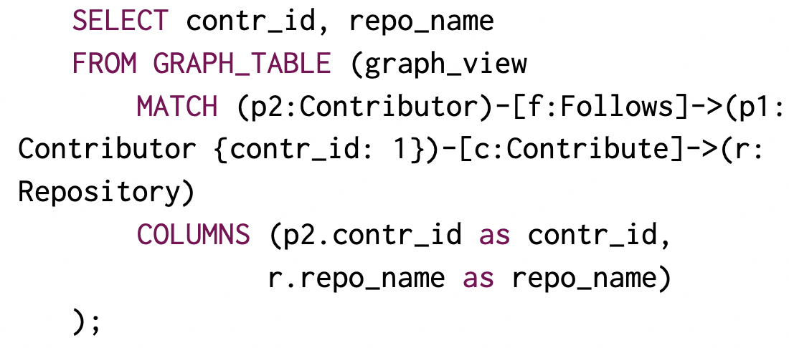
Optimizer for SQL/PGQ
Rel+
Translate graph queries to relational queries, and introduce index-based joins
- GrainDB
find the contributors v1 is following,
and repos v1 contributing to
$p1→f→p2→c→r⇒$ Contributor $→$Follows $→$Contributor $→$Contribute $→$Repository
$$⇒p1→p2→r$$

Slide 10
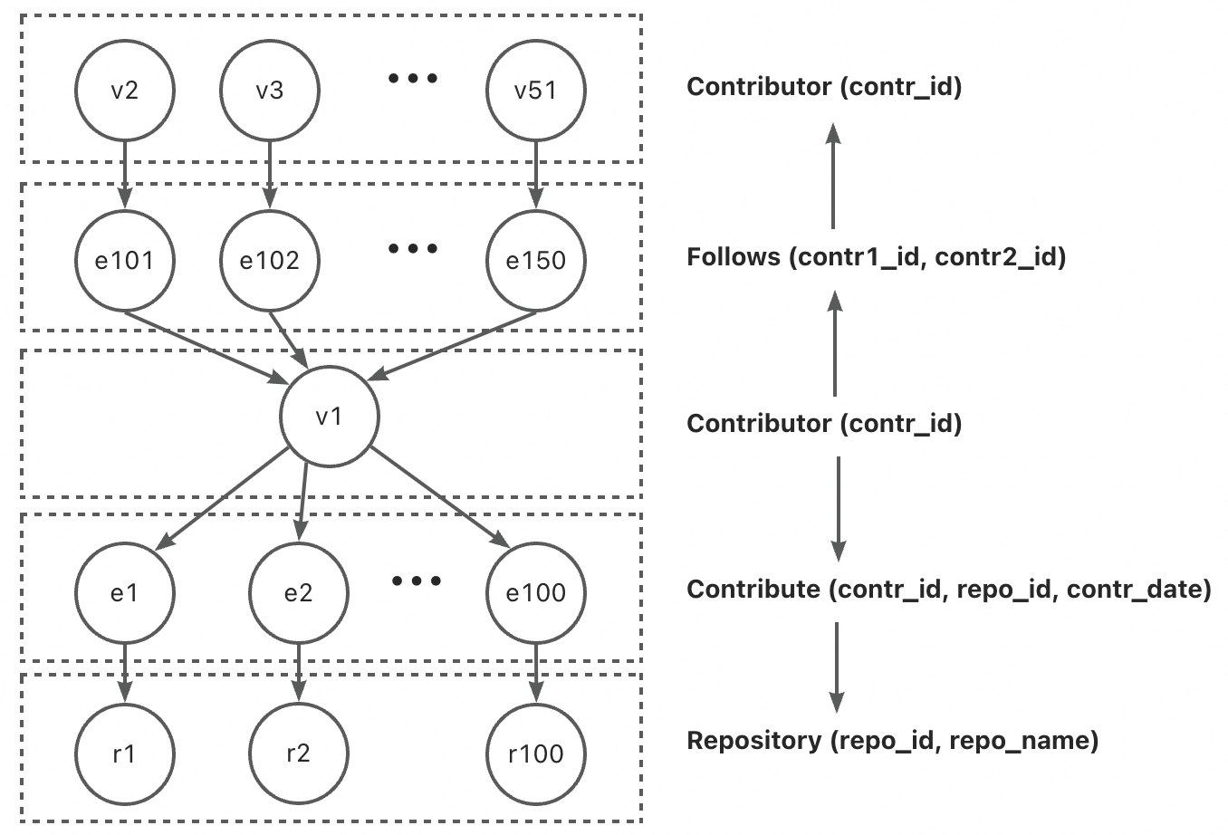
Optimizer for SQL/PGQ
Rel+
Translate graph queries to relational queries, and introduce index-based joins
- GrainDB
find the contributors v1 is following,
and repos v1 contributing to
$p1→f→c→p2→r⇒$ Contributor $→$Follows $→$Contribute $→$ Contributor $→$Repository
$⇒$Hash join cannot be replaced with GetNeighbor

Slide 11
Optimizer for SQL/PGQ
Rel+
Translate graph queries to relational queries, and introduce index-based joins
- GrainDB
find the contributors v1 is following,
and repos v1 contributing to
$p1→f→c→p2→r⇒$ Contributor $→$Follows $→$Contribute $→$ Contributor $→$Repository
$⇒$Hash join cannot be replaced with GetNeighbor

Slide 12
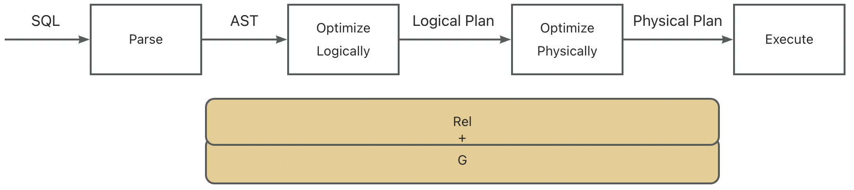
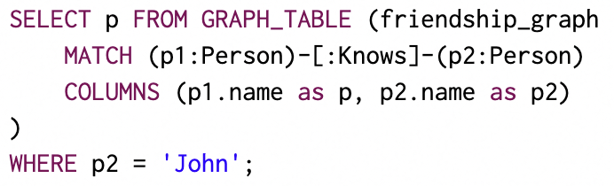
Optimizer for SQL/PGQ
Rel+G
Relational optimizer optimizes the relational query,
Graph optimizer optimizes the graph query
find persons that know John
First, the graph query is optimized, and the results form a table with two columns (p, p2).
Then, the relational query is optimized.

Slide 13
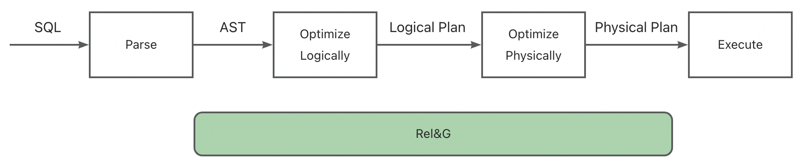
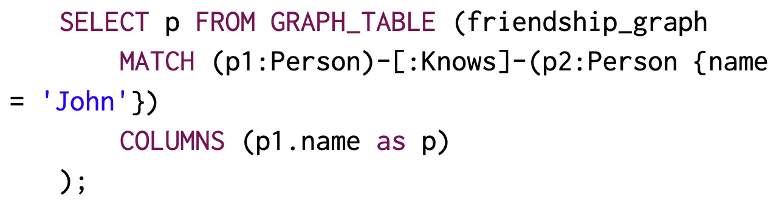
Optimizer for SQL/PGQ
Rel&G
Relational optimizer optimizes the relational query,
Graph optimizer optimizes the graph query,
with constraints push down
find persons that know John

Slide 14
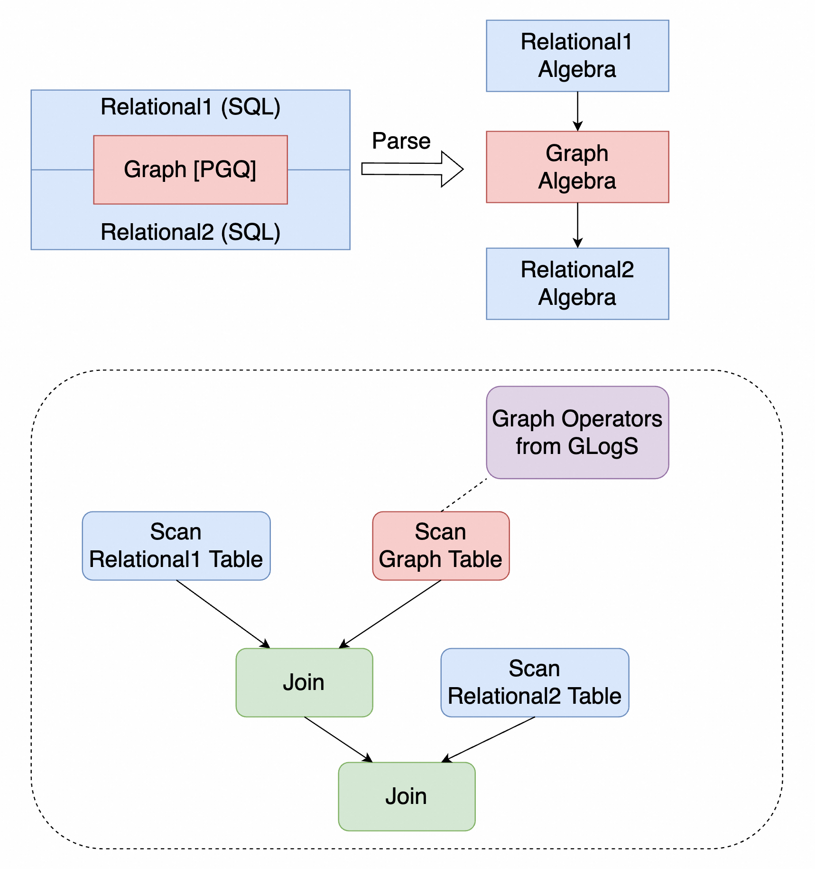
Overview

Slide 15
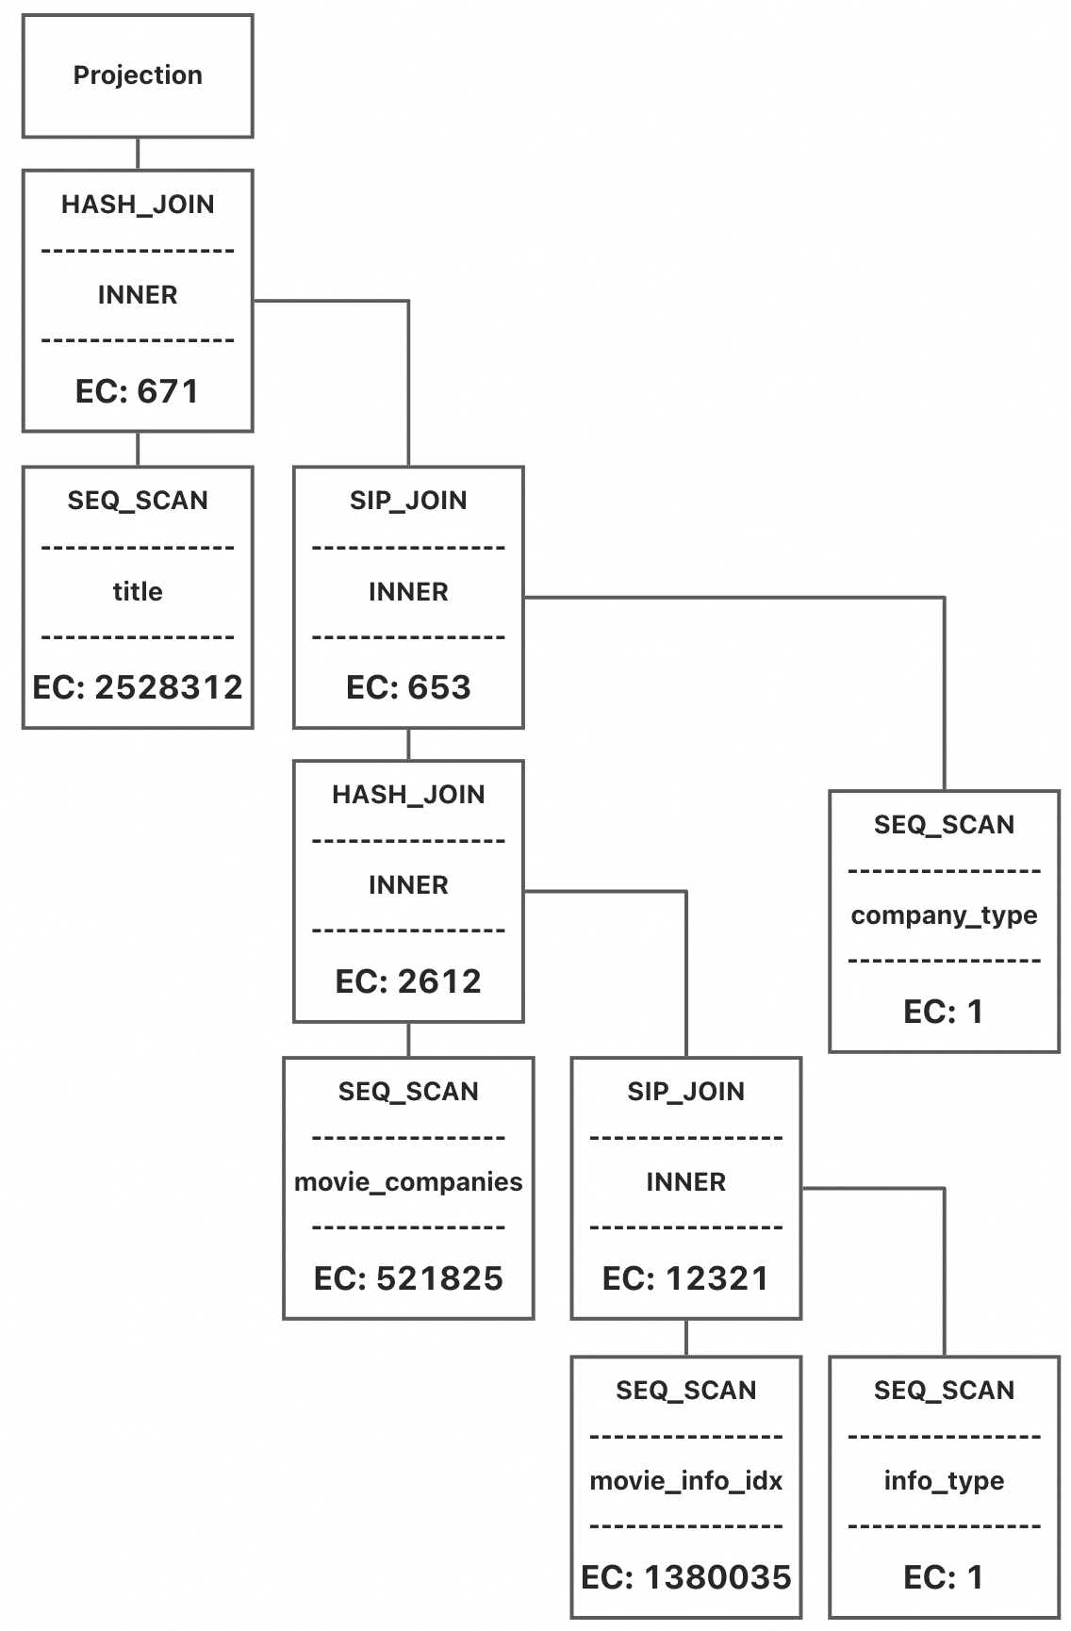
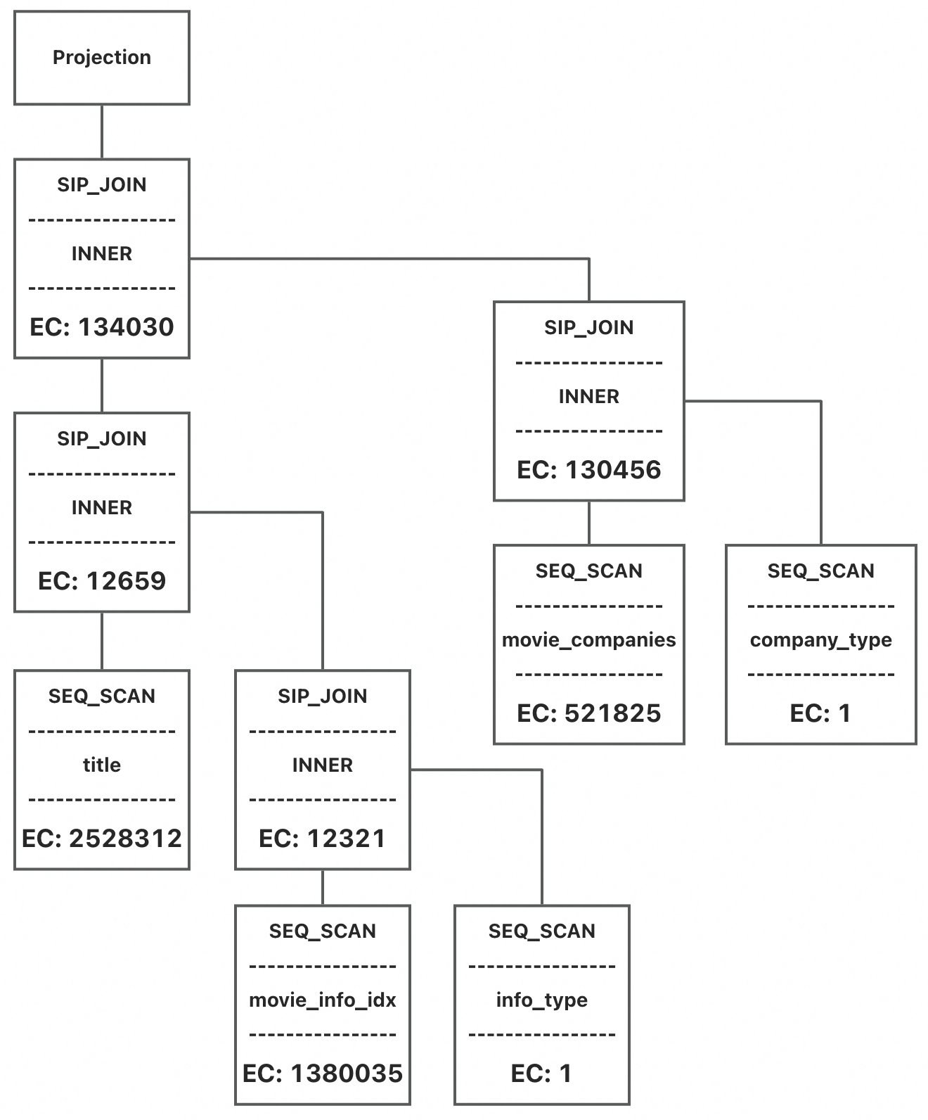
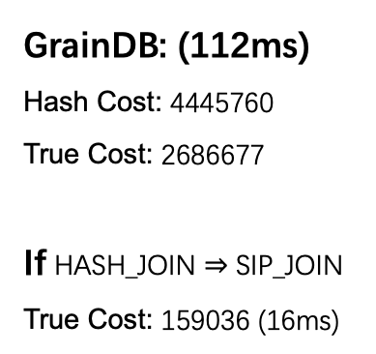
Overview
Benefit 1: Better Cost Estimation
GrainDB: (112ms)
Hash Cost: 4445760
True Cost: 2686677
If HASH_JOIN $⇒$ SIP_JOIN
True Cost: 159036 (16ms)
Ours: (19ms)
Hash Cost: 4585610
True Cost: 168097

Slide 16
Overview
Benefit 2: Better Leveraging Graph Indices
That is, in the graph query, cost of GetNeighbor is considered in finding the optimal plan
$p1→f→c→p2→r⇒$ Contributor $→$Follows $→$Contribute $→$ Contributor $→$Repository
$⇒$Hash join cannot be replaced with GetNeighbor

Slide 17
Overview
Benefit 3: FilterIntoMatchRule & SetPullupRule
FilterIntoMatchRule

Slide 18
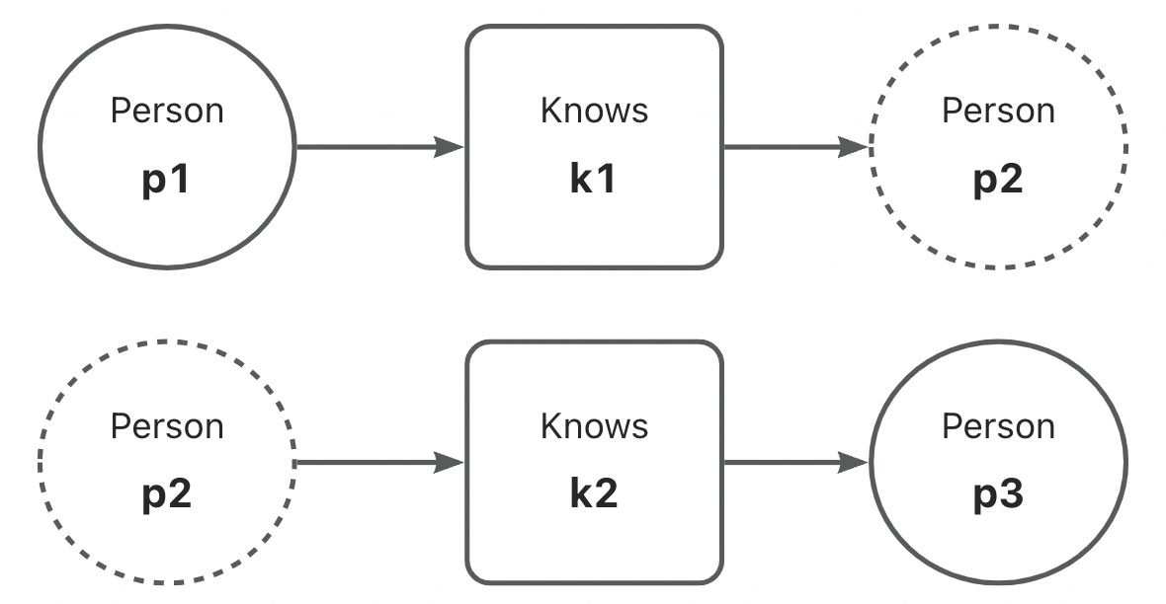
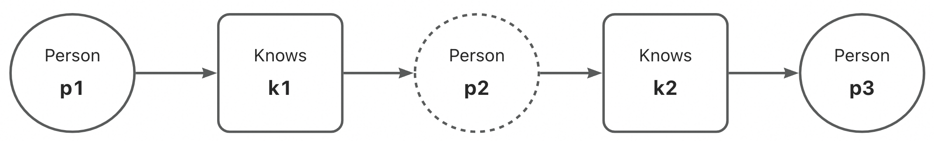
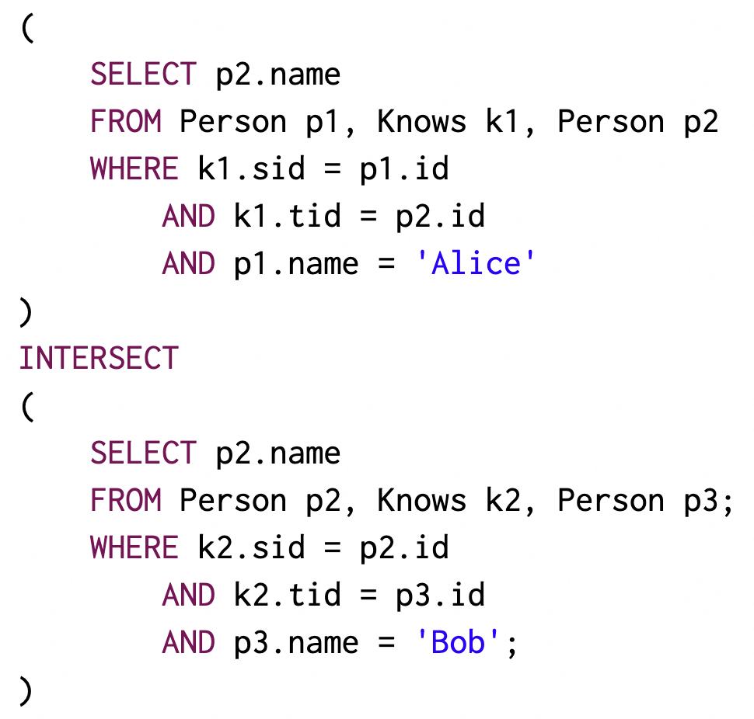
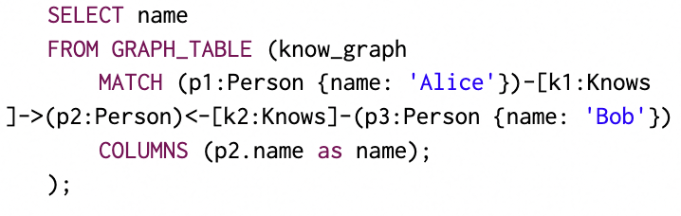
Overview
Benefit 3: FilterIntoMatchRule & SetPullupRule
SetPullupRule

Slide 19
Experimental Results
sf10 (ms) | q1-1 | q1-2 | q1-3 | q2-1 | q3-1 | q3-2 | q4-1 | q5-1 | q5-2 | q6-1 | q6-2
DuckDB | 17.84 | 60.27 | 523.16 | 744.78 | 2171.57 | 29842.29 | 332.75 | 625.39 | 3072.73 | 310.65 | 970.33
GrainDB w. RAI | 5.24 | 28.92 | 501.73 | 235.47 | 2540.67 | 30155.29 | 146.78 | 197.49 | 2694.96 | 88.65 | 592.61
Ours | 3.25 | 25.96 | 198.80 | 210.96 | 1223.14 | 28352.51 | 36.80 | 62.86 | 2027.16 | 14.55 | 524.21
 | q7-1 | q8-1 | q9-1 | q9-2 | q11-1 | q11-2 | q12-1
DuckDB | 618.65 | 961.29 | 300.76 | 1640.37 | 17.53 | 72.31 | 1412.12
GrainDB w. RAI | 92.18 | 18.78 | 73.02 | 855.31 | 7.53 | 37.63 | 953.45
Ours | 20.00 | 17.55 | 64.75 | 789.76 | 6.0 | 24.43 | 338.06

Slide 20
Experimental Results
sf30 (ms) | q1-1 | q1-2 | q1-3 | q2-1 | q3-1 | q3-2 | q4-1 | q5-1 | q5-2 | q6-1 | q6-2
DuckDB | 42.31 | 175.35 | 1164.16 | 2149.51 | 3882.82 | 101217.63 | 861.57 | 1919.53 | 8481.12 | 1040.82 | 2867.38
GrainDB w. RAI | 7.86 | 70.61 | 1073.82 | 395.16 | 3940.12 | 112099.88 | 286.14 | 449.67 | 6878.43 | 217.20 | 1284.63
Ours | 4.14 | 64.33 | 376.78 | 374.47 | 1781.20 | 81408.80 | 64.15 | 143.51 | 5419.00 | 19.53 | 992.75
 | q7-1 | q8-1 | q9-1 | q9-2 | q11-1 | q11-2 | q12-1
DuckDB | 2506.98 | 2900.31 | 845.06 | 5070.61 | 40.25 | 223.25 | 2913.57
GrainDB w. RAI | 1172.55 | 50.39 | 135.47 | 2231.10 | 12.65 | 94.12 | 2861.57
Ours | 39.51 | 44.57 | 122.73 | 2031.98 | 7.84 | 47.67 | 590.45

Slide 21
Experimental Results
JOB (ms) | 1a | 2a | 3a | 4a | 5a | 6a | 7a | 8a | 9a | 10a | 11a
GrainDB | 379 | 424 | 1383 | 782 | 387 | 893 | 1120 | 1349 | 2541 | 1745 | 313
GrainDB w. RAI | 224 | 221 | 594 | 517 | 366 | 330 | 451 | 613 | 1082 | 714 | 214
Ours | 35 | 143 | 320 | 348 | 49 | 53 | 107 | 455 | 770 | 620 | 47
 | 12a | 13a | 14a | 15a | 16a | 17a | 18a | 19a | 20a | 21a | 22a
GrainDB | 843 | 1386 | 1339 | 1026 | 1083 | 3185 | 2966 | 3279 | 2267 | 1211 | 1576
GrainDB w. RAI | 506 | 393 | 285 | 528 | 382 | 2797 | 2233 | 1287 | 1231 | 221 | 543
Ours | 211 | 257 | 240 | 399 | 286 | 2249 | 2087 | 1202 | 1186 | 62 | 482
 | 23a | 24a | 25a | 26a | 27a | 28a | 29a | 30a | 31a | 32a | 33a
GrainDB | 1818 | 3783 | 2750 | 3416 | 931 | 2231 | 2785 | 2920 | 2789 | 46 | 520
GRainDB w. Index | 492 | 1580 | 2251 | 1028 | 295 | 1340 | 487 | 1449 | 2165 | 10 | 348
Ours | 327 | 1194 | 2244 | 682 | 136 | 1045 | 314 | 1235 | 2043 | 8 | 181

